Slide 1
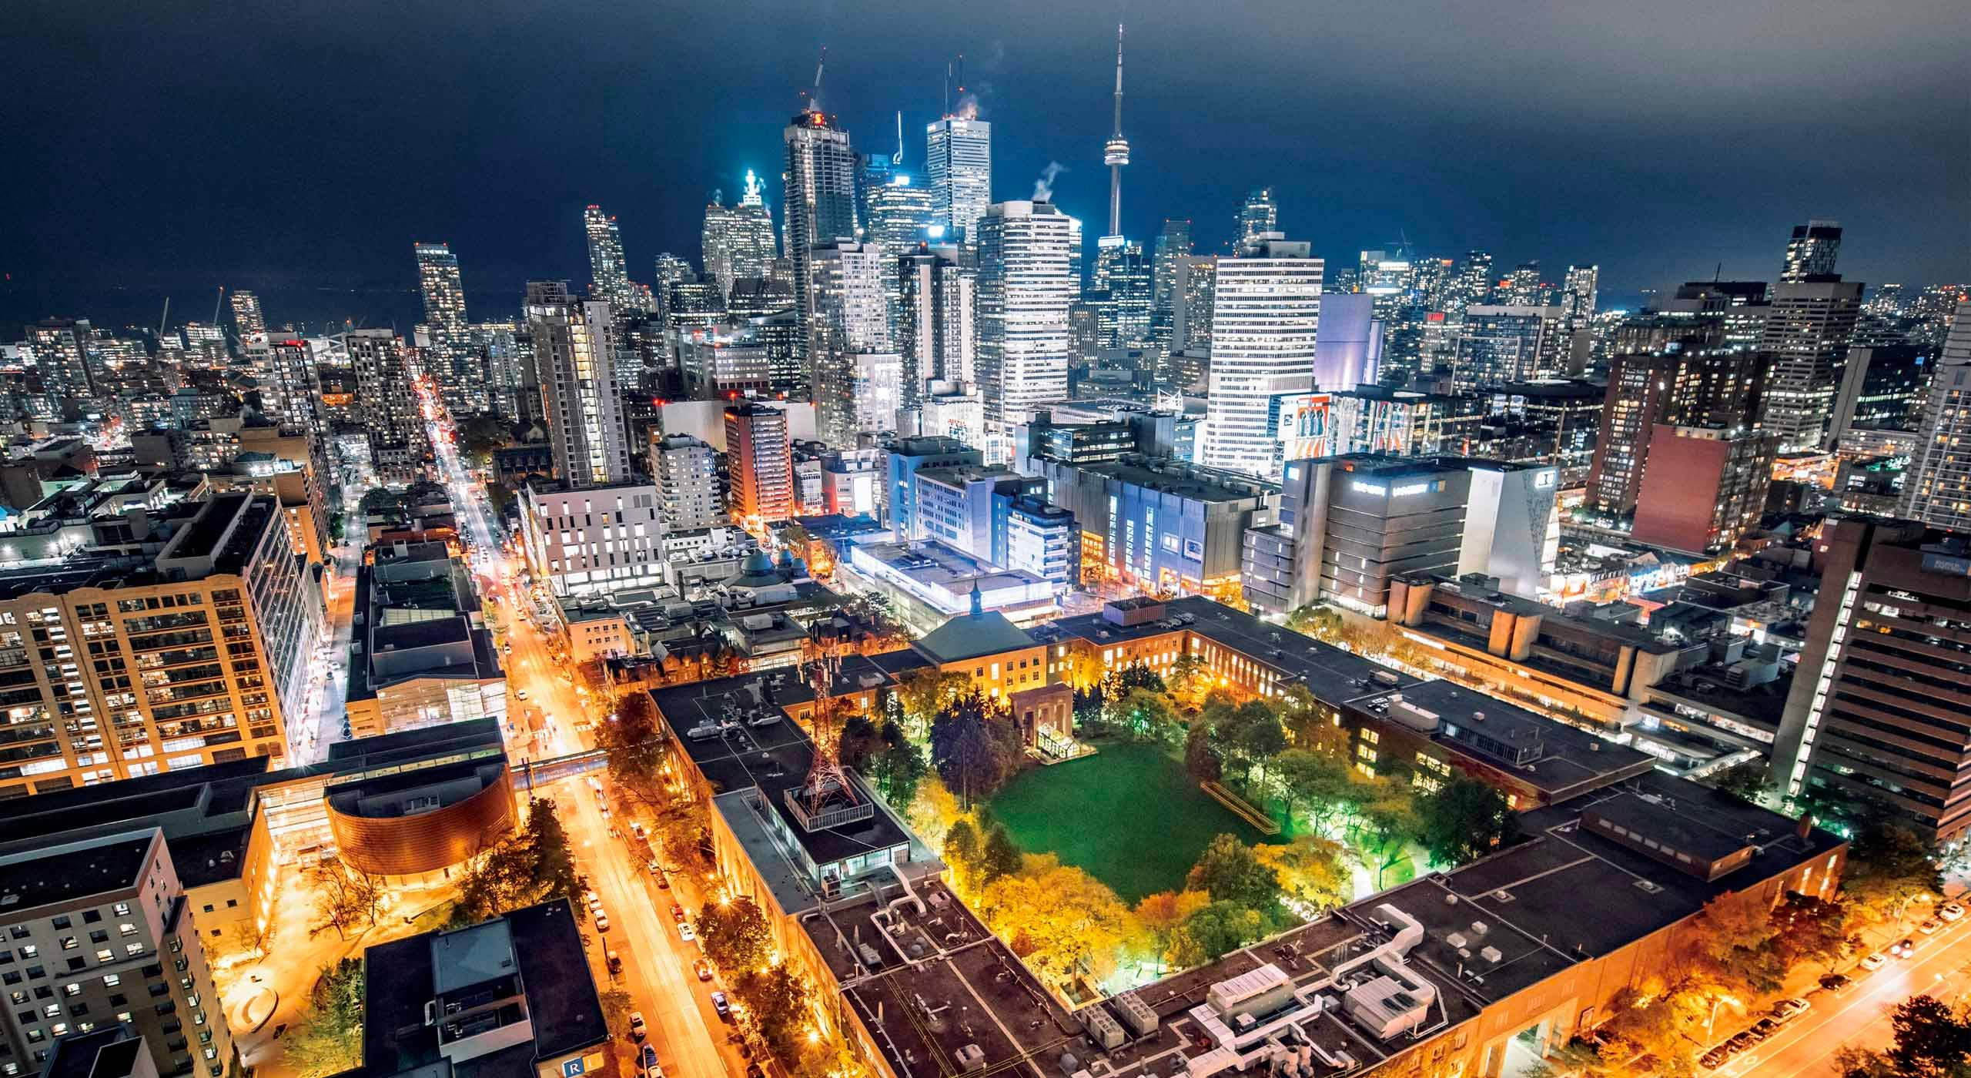
The Battle of Neighborhoods: Finding the Best Location for an African/Caribbean Store and Restaurant in Toronto, CAN

Slide 2
OUTLINE
INTROUCTION
DATA
METHODOLOGY
RESULT
DISCUSSION
CONCLUSION

Slide 3
Introduction
The purpose of this project is to find the best neighborhood for an African/ Caribbean restaurant
This project will interest entrepreneur trying to setup Afro-Caribbean store and restaurant to capitalize on the increase in population
The idea is to categorize the neighborhood into clusters and apply the Foursquare API to find the neighborhood with the least number of Afro-Caribbean stores or restaurants

Slide 4
DATA
Foursquare API data for different neighborhood in Toronto were used: The data retrieved from Foursquare contained information of venues within a specified distance of the longitude and latitude of the postcodes
The information obtained per venue as follows: Neighborhood, latitude, longitude. Venue, venue latitude, venue longitude, venue category
For the Neighborhood data will be scrapping the data from the Canadian neighborhood Wikipedia page page https://en.wikipedia.org/wiki/List_of_postal_codes_of_Canada:_M as well as the Geospatial data https://cocl.us/Geospatial_data

Slide 5
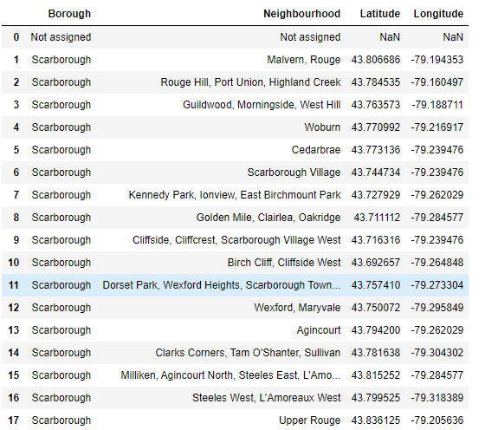
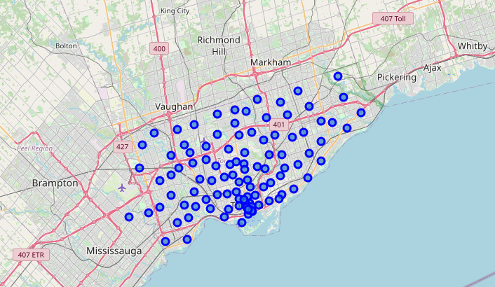
METHODOLOGY
Once Data is Scraped from the wiki page and geospatial data
First step in this project is to clean raw data and put them in a presentable data frame
Next is to Visualize the neighborhood in Toronto on a Map

Slide 6
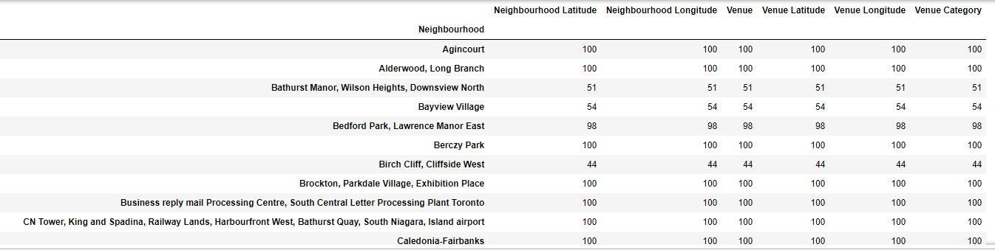
METHODOLOGY Cont’D
Exploring location of all the neighbourhood for Venues and try to extract Afro related restaurant

Slide 7
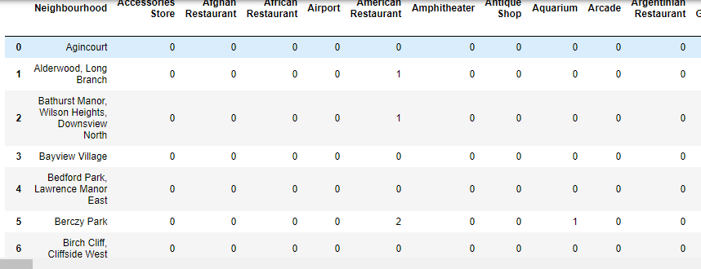
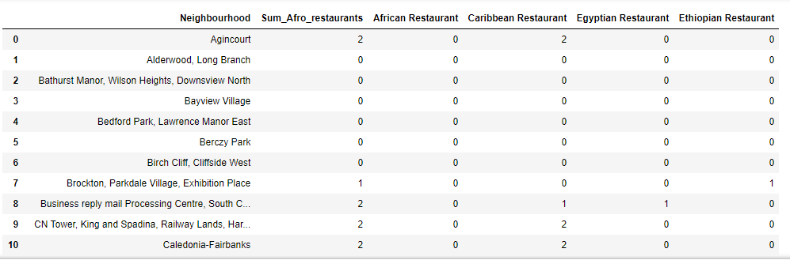
METHODOLOGY Cont’d
One hot coding was applied to put the data in new data frame and venue categories arranged by neighbourhood
African related restaurant were then extracted from this data and a sum was created for each neighbourhood
K- Means Algorithm was employed in clustering the neighbourhood

Slide 8
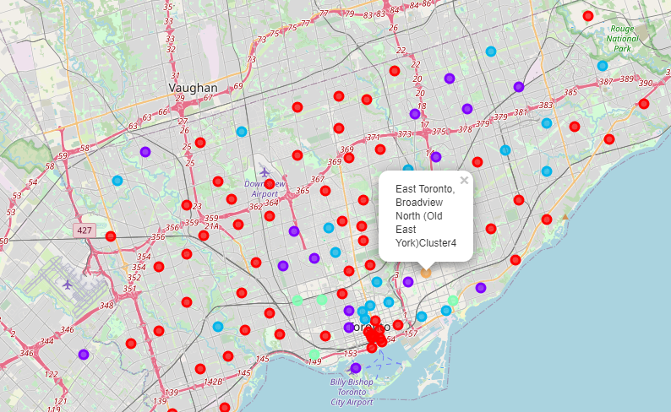
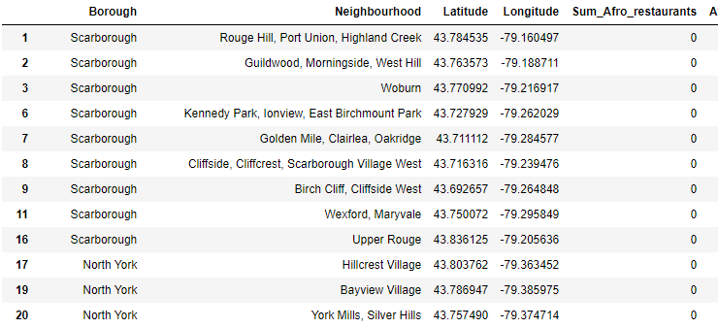
Results
Cluster map of various African related restaurant Venues
Cluster 1: No African/Caribbean Related Restaurant represented by Red Circles on the Map

Slide 9
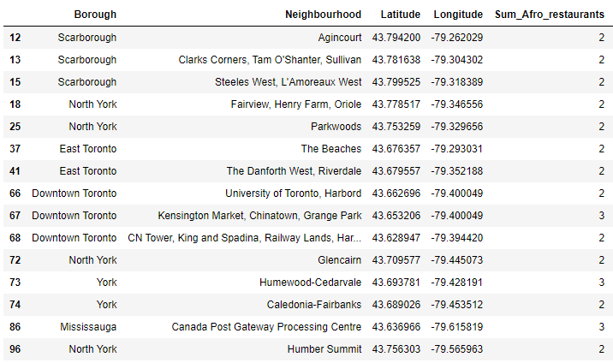
Results
Cluster map of various African related restaurant Venues
Cluster 2: Two or Three African/Caribbean Related Restaurant represented by Purple Circles on the Map

Slide 10
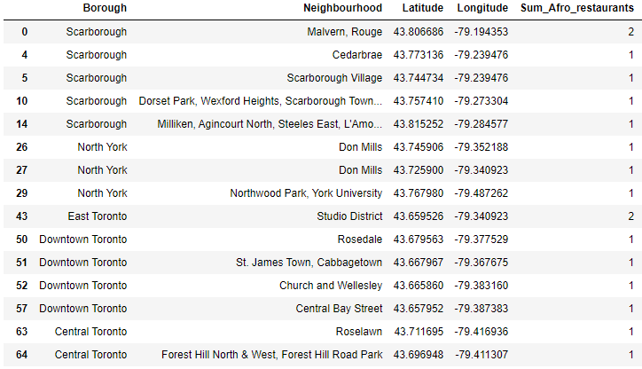
Results
Cluster map of various African related restaurant Venues
Cluster 3: Two or One African/Caribbean Related Restaurant represented by Blue Circles on the Map

Slide 11
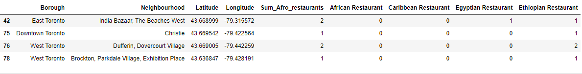
Results
Cluster map of various African related restaurant Venues
Cluster 4: Mostly East African/Egyptian Restaurants, represented By Green circles on the Map

Slide 12
Results
Cluster map of various African related restaurant Venues
Cluster 5: Highest Number of African/Caribbean related Restaurants represented by Orange Circle on the Map

Slide 13
DISCUSSION
The highest concentration Of African related restaurant were found around East York-woodbine heights and East Toronto, Broadview North
There were no African related restaurant in around cluster 1 mostly Scarborough region and North York.
Cluster 3 areas especially Etobicoke appears to be the optimal Neighbourhood for new Business as there are few existing African related restaurants
Clusters 1 and 5 are least probable due non-existence of African related restaurant in cluster 1 and over representation in cluster 5
Cluster1 clearly shows that there are no markets at all signifying area dominated by other ethnicity. cluster 5 is over subscribed and would not be advised

Slide 14
CONCLUSION
In this project, Toronto, Canada neighbourhoods were identified and most common venues extracted and the data utilized to obtain African related restaurant and clusters created
Increasing number of migrants of African decent to Canada especially the Greater Toronto area present a larger market (away from eastern Toronto)
The clusters created were used to draw conclusion on where it is optimal to situate a new African related restaurant
The result in this Project could be used by entrepreneurs alike trying to set-up African Grocery Store in the Toronto area

